Slide 1

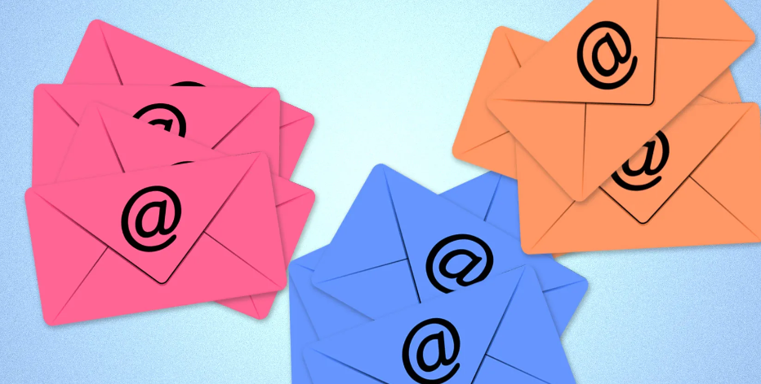
AI BASED EMAIL SORTING SYSTEM
TECHNO INTERNATIONAL NEW TOWN
Presented by -
Name : Anwarul Haque
Roll No. : 18700221042
Branch : Information Technology
Section : ‘A’
Subject : Artificial Intelligence
(PEC-IT 501B)

Slide 2

PROBLEM STATEMENT
Every day, we find ourselves grappling with the overwhelming influx of emails, ranging from work communications and important updates to promotional offers and social notifications.
As the volume of emails continues to rise, so does the challenge of sifting through them to find what truly matters.
This persistent struggle inspired the development of an intelligent solution that harnesses the power of AI to transform your email experience.

Slide 3

INTRODUCTION
Effective email management has become a crucial component of our daily routines in the fast-paced digital world. The demand for a better, more effective solution has never been greater due to the volume of emails that are overflowing our inboxes.
Enter the world of artificial intelligence (AI), where ease and innovation coexist together. Introducing the AI-Based Email Sorting System, a ground-breaking method for controlling the mayhem in your inbox and increasing productivity.

Slide 4

OBJECTIVE
The main objective of the AI-based email sorting system is to automate the process of categorizing emails for improved efficiency in email management.
The system aims to accurately sort incoming emails into relevant categories such as work, personal, promotions, and social. This automation reduces the manual effort required for sorting emails, allowing users to focus on more important tasks.

Slide 5
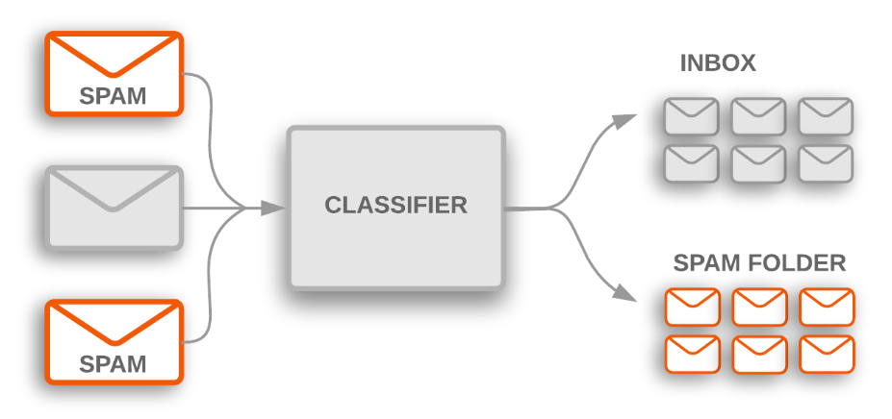
SOLUTION
The solution involves developing an AI model that utilizes the Naive Bayes algorithm to analyse the content of emails and classify them into appropriate categories.
By training the AI model on a dataset of labelled emails, it learns patterns and associations in the text to make accurate categorization decisions.
The system provides users with a streamlined approach to managing their inbox, making email organization more effective and time-efficient.

Slide 6

MOTIVATION
The motivation behind this idea stems from the increasing volume of emails individuals receive on a daily basis.
Manual email sorting can be time-consuming and prone to errors, leading to missed important emails or confusion in organization.
By implementing an AI-based solution, users can benefit from a reliable and automated categorization process, resulting in improved productivity and reduced inbox clutter.
This project also serves as a practical application of AI techniques, showcasing their potential to enhance everyday tasks and workflows.

Slide 7
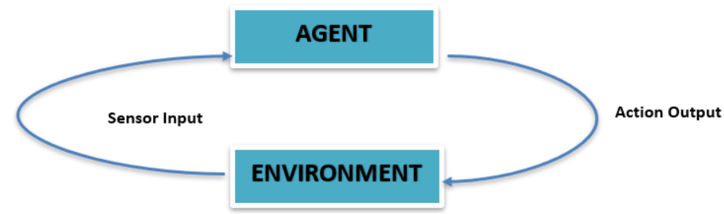
PEAS (Performance measure, Environment, Actuators, and Sensors)
Performance Measure:
The performance measure for the AI-based email sorting system is the accuracy of email categorization.
It is determined by comparing the system's predicted categories with the actual categories of a test dataset of emails.
Environment:
The environment for the AI-based email sorting system consists of the email dataset and the interactions with users. The dataset contains various emails with different content and categories (e.g., work, personal, promotions, social).
Users interact with the system by submitting emails for categorization and receiving the sorted categories as output.

Slide 8
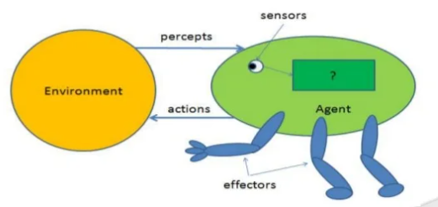
PEAS DESCRIPTION
Actuators:
The actuators in the system are the components responsible for performing actions. In this case, the primary actuator is the categorization algorithm, which uses the Naive Bayes algorithm.
It takes the textual content of an email as input and determines the appropriate category for the email. Once the category is determined, the algorithm sends the result to the output mechanism.
Sensors:
The sensors in the system are responsible for gathering information from the environment. In this context, the sensors analyse the content of incoming emails and extract features from the text.
These features are then used by the categorization algorithm to make predictions about the appropriate category for each email. Additionally, the system may use sensors to receive user inputs and requests for categorization.

Slide 9
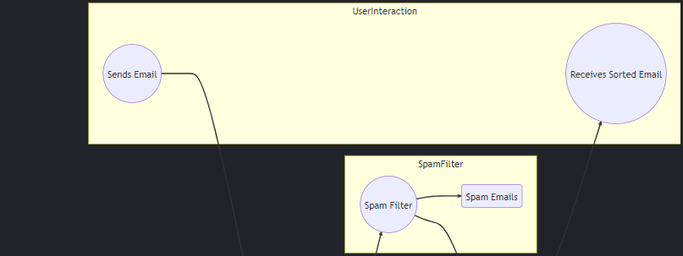
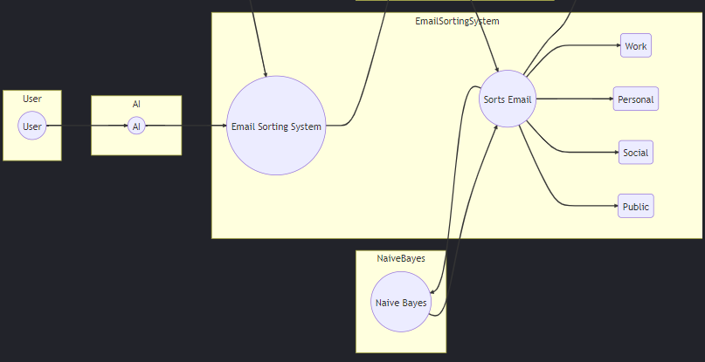
USE CASE DIAGRAM

Slide 10

USE CASES
Efficient Email Organization:
Use Case: Users want to efficiently organize their incoming emails without spending a lot of time on manual sorting.
Scenario: Users submit their incoming emails to the AI-based system, which automatically categorizes the emails into relevant folders (e.g., work, personal, promotions, social) based on the content analysis.
Benefit: Users can easily locate and manage their emails in a well-organized manner, leading to increased productivity and reduced clutter in their inbox.
Time-Saving Email Management:
Use Case: Users receive a high volume of emails and need a solution to quickly categorize and prioritize them.
Scenario: The AI-based system sorts emails based on their content, allowing users to focus on important emails first and reducing the time spent on manual sorting.
Benefit: Users can save time by avoiding the manual sorting process, enabling them to respond promptly to important emails and allocate more time to other tasks.
Enhanced Email Search and Retrieval:
Use Case: Users struggle to find specific emails buried in their inbox due to the sheer volume of messages.
Scenario: The AI-based system categorizes emails accurately, making it easier for users to locate and retrieve specific emails by searching within the relevant categories.
Benefit: Users can quickly find past emails related to specific topics or projects, enhancing their ability to reference important information.

Slide 11
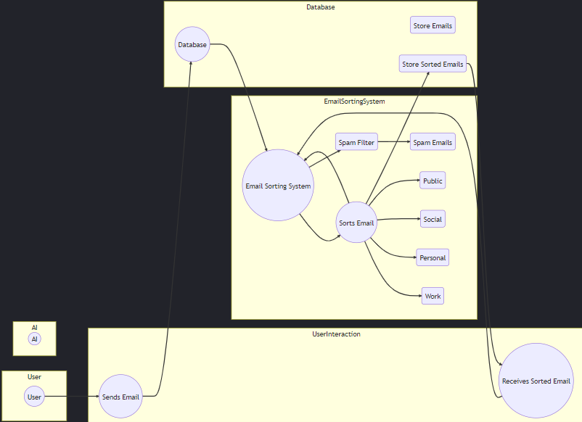
DATA FLOW DIAGRAM

Slide 12
PROBABLE APPLICATION AND COST
Applications:
Personal use: Individuals can use an AI email sorting system to stay organized and to find the information they need quickly.
Business use: Businesses can use an AI email sorting system to improve their communication and productivity. For example, an AI email sorting system could be used to automatically sort customer support emails into different categories, such as "new customer inquiries," "support tickets," and "resolved issues." This would help customer support representatives to quickly find the information they need to answer customer questions.
Government use: Governments can use an AI email sorting system to manage their email communications more efficiently. For example, an AI email sorting system could be used to automatically sort government procurement emails into different categories, such as "bid invitations," "contract awards," and "invoices." This would help government procurement officers to quickly find the information they need to manage the procurement process.
Cost
The cost of a basic design for an AI email sorting system will vary depending on the specific features and functionality that are required. However, the cost is likely to be relatively low, as the system can be implemented using open-source software and cloud computing resources.
Here is a breakdown of the estimated costs for a basic design for an AI email sorting system:
Hardware: The hardware costs for a basic design will be minimal, as the system can be implemented using a laptop or desktop computer with a standard internet connection.
Software: The software costs for a basic design will also be minimal, as the system can be implemented using open-source software, such as Python and Scikit-learn.

Slide 13
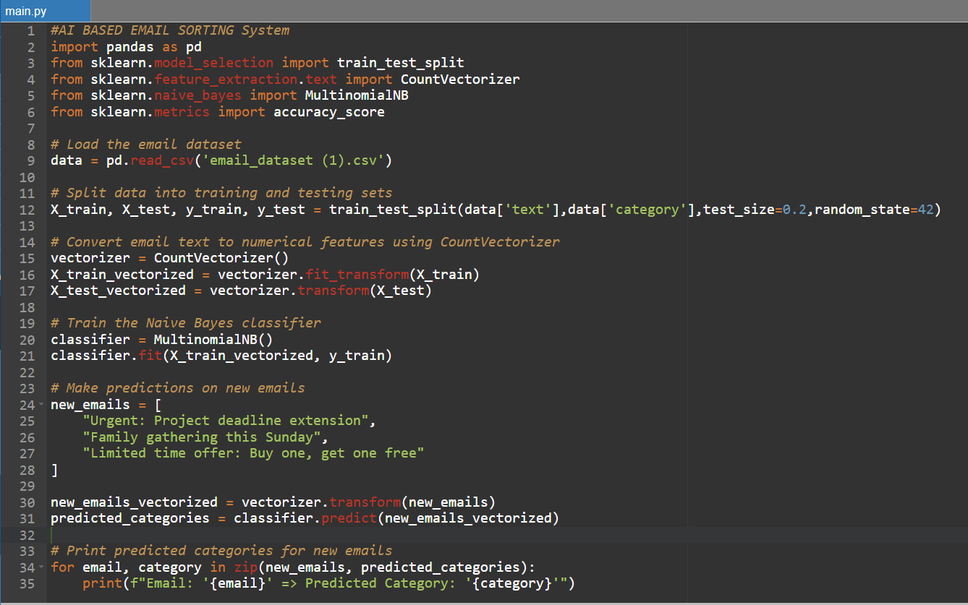
IMPLEMENTATION
This is a simplified implementation using Python and scikit-learn's Naive Bayes algorithm.
Step 1: Set Up Environment
Install required libraries using pip install pandas scikit-learn.
Step 2: Prepare Dataset
Create a CSV file named "email_dataset(1).csv" with "text" and "category" columns. Populate it with sample email data and categories.
Step 3: Implementation of code

Slide 14
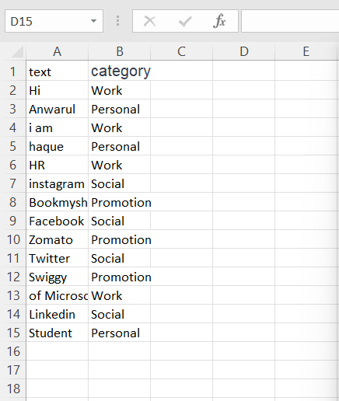
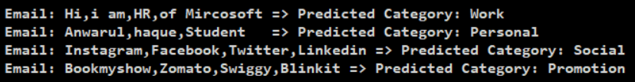
Content of email_dataset(1).csv
OUTPUT
This implementation reads the dataset, converts the email text to numerical features, trains a Naive Bayes classifier, and then uses the classifier to predict the category for new emails.

Slide 15
KEYS TAKEWAYS
Here are some key takeaways to keep in mind when implementing an AI-based email sorting system:
Data Quality: The quality of your dataset significantly impacts the performance of your AI model. Ensure the dataset is labeled accurately and represents real-world scenarios.
Algorithm Selection: Choose a suitable algorithm based on the nature of your problem. For text classification like email sorting, Naive Bayes, SVM, and neural networks are commonly used.
Training and Testing: Split your dataset into training and testing sets to evaluate your model's performance accurately. Avoid training on the testing data.
Security: Implement appropriate security measures to protect user data and prevent unauthorized access to the system.

Slide 16
THANK YOU!!

